Slide 1
Lecture 1: Data and Attributes
Mr. Vaibhav Chunekar
Assistant Professor
KJSCE
Date: 26/7/2023

Slide 2
What is a data?
Data is a collection of facts. This collection can include numbers, pictures, videos, words, measurements, observations, and more.
Data analysis is the collection, transformation, and organization of data in order to draw conclusions, make predictions, and drive informed decision-making.
Data analytics can give us new information throughout data's entire life cycle.

Slide 3
How Data Analysis helps?
Data is everywhere. You use and create data everyday. Have you ever read reviews of a product before deciding whether or not to buy it? That's data analysis.
Or maybe you wear a fitness tracker to count your steps so you can stay active throughout the day. That's data analysis

Slide 4
How do you create Data and role of Data Analyst?
You also create huge amounts of it every single day.
Any time you use your phone, look up something online, stream music, shop with a credit card, post on social media or use GPS to map a route, you're creating data.
Data analyst is someone who collects, transforms, and organizes data in order to help make informed decisions

Slide 5
What is Data?
Collection of data objects and their attributes
An attribute is a property or characteristic of an object
Examples: eye color of a person, temperature, etc.
Attribute is also known as variable, field, characteristic, dimension, or feature
A collection of attributes describe an object
Object is also known as record, point, case, sample, entity, or instance
Attributes
Objects

Slide 6
Attribute Values
Attribute values are numbers or symbols assigned to an attribute for a particular object
Distinction between attributes and attribute values
Same attribute can be mapped to different attribute values
Example: height can be measured in feet or meters
Different attributes can be mapped to the same set of values
Example: Attribute values for ID and age are integers
But properties of attribute can be different than the properties of the values used to represent the attribute

Slide 7
Measurement of Length
The way you measure an attribute may not match the attributes properties.
This scale preserves only the ordering property of length.
This scale preserves the ordering and additvity properties of length.

Slide 8
Types of Attributes
Qualitative: Qualitative data is descriptive in nature, expressed in terms of language rather than numerical values
Quantitative: Quantitative data refers to any information that can be quantified, counted or measured, and given a numerical value

Slide 9
Qualitative Data
Descriptive, expressed in terms of language rather than numerical values
Usually it describes information and cannot be measured or counted.
We can say it refers to the words or labels used to describe certain characteristics or traits
You would turn to qualitative data to answer the "why?" or "how?" questions.
It is often used to investigate open-ended studies, allowing participants (or customers) to show their true feelings and actions without guidance.

Slide 10
Example of Qualitative Data
The sunflowers had a fresh smell that filled the office.
All the bagels with bites taken out of them had cream cheese.
The man had blonde hair with a blue hat.

Slide 11
Quantitative data
Quantitative data refers to any information that can be quantified — that is, numbers.
Quantitative research is based on numeric data.
If it can be counted or measured, and given a numerical value, it's quantitative in nature.
Quantitative variables can tell you "how many," "how much," or "how often."

Slide 12
Some Examples Quantitative Data
How many people attended last week's webinar?
How much revenue did our company make last year?
How often does a customer click on some app?

Slide 13
Key Difference between Qualitative and Quantitative
Quantitative data is numbers-based, countable, or measurable. Qualitative data is interpretation-based, descriptive, and relating to language.
Quantitative data tells us how many, how much, or how often in calculations. Qualitative data can help us to understand why, how, or what happened behind certain behaviors.
Quantitative data is fixed and universal. Qualitative data is subjective and unique.
Quantitative research methods are measuring and counting. Qualitative research methods are interviewing and observing.
Quantitative data is analyzed using statistical analysis. Qualitative data is analyzed by grouping the data into categories and themes.

Slide 16
Types of Attributes
There are different types of attributes
Nominal
Examples: ID numbers, eye color, zip codes
Ordinal
Examples: rankings (e.g., taste of potato chips on a scale from 1-10), grades, height {tall, medium, short}
Interval
Examples: calendar dates, temperatures in Celsius or Fahrenheit.
Ratio
Examples: temperature in Kelvin, length, counts, elapsed time (e.g., time to run a race)

Slide 17
Properties of Attribute Values
The type of an attribute depends on which of the following properties/operations it possesses:
Distinctness: = ≠
Order: < >
Differences are + - meaningful :
Ratios are * / meaningful
Nominal attribute: distinctness
Ordinal attribute: distinctness & order
Interval attribute: distinctness, order & meaningful differences
Ratio attribute: all 4 properties/operations

Slide 18
Difference Between Ratio and Interval
Is it physically meaningful to say that a temperature of 10 ° is twice that of 5° on
the Celsius scale?
the Fahrenheit scale?
the Kelvin scale?
Consider measuring the height above average
If Bill’s height is three inches above average and Bob’s height is six inches above average, then would we say that Bob is twice as tall as Bill?
Is this situation analogous to that of temperature?

Slide 19
Quantitative Data
Discrete data is a numerical type of data that includes whole, concrete numbers with specific and fixed data values determined by counting.
Continuous data includes complex numbers and varying data values measured over a particular time interval.

Slide 20
Discrete data
Discrete data refers to countable, individualized, and nondivisible figures in statistics. These data points exist only in set increments. Data analysts and statisticians visualize discrete data using bar graphs, line charts, histograms, and pie charts.
Discrete data represents discrete variables, which you can count in a finite amount of time. The key feature here is that these variables are countable instead of measurable.
For example, if you track the number of push-ups you do each day for a month, an underlying goal is to evaluate your progress and the rate of improvement. With that said, your daily tally is a discrete, isolated number.

Slide 21
Continuous data
Continuous data is a type of numerical data that refers to the unspecified number of possible measurements between two realistic points.
These numbers are not always clean and tidy like those in discrete data, as they're usually collected from precise measurements.
Over time, measuring a particular subject allows us to create a defined range where we can reasonably expect to collect more data.

Slide 22
Continuous Data
Continuous data is all about accuracy.
So, continuous variables often carry decimal points, with the number to the right stretched out as far as possible.
These decimal points offer an exact measurement between two defined data points.
This level of detail is paramount for scientists, doctors, and manufacturers, to name a few.
Regression analysis is one of the most common types of continuous data analysis.
When you think of experiments or studies involving constant measurements, they're likely to be continuous variables to some extent. If you have a number like "2.86290" anywhere on a spreadsheet, it's not a number you could have quickly arrived at — think of measurement devices like stopwatches, scales, thermometers, etc.

Slide 23
Examples of continuous data
Daily wind speed
Freezer temperature
Weight of newborn babies
Length of customer service calls
Product box measurements and weight

Slide 24
Differences between Discrete and continuous
Discrete data | Continuous data
Value | Countable and finite | Any measured value within a specific range
Components | Ordinal and integer data values | Quantitative data points such as fractions, decimal numbers, and percentages
Countability and measurability | Counted on something as simple as a number line | Measured using in-depth measurement tools and methods like curves and skews
Divisibility | Nondivisible | Subdivisible
Granularity | Less | More
Nature | Remains constant over a specific time interval | Varies over time and can have separate values ​​at any given point
Common examples | The number of students, the number of children, the shoe size, etc. | Height, weight, length, time, temperature, age, etc.

Slide 25
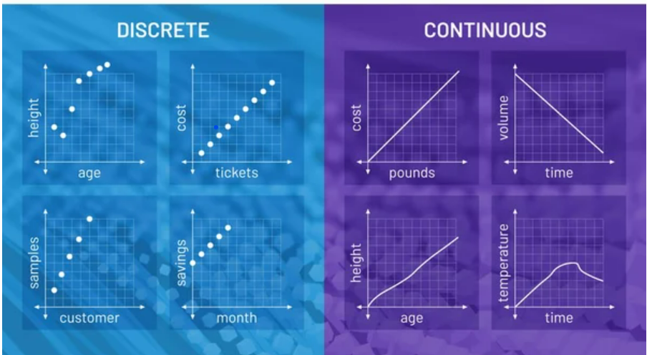
Difference Imagine using Graphs

Slide 27
Summary
What is a Data? Role of Data Analyst in a society?
Exploratory Data Analysis- Data and Attributes
Measurements of Length
Attributes and Types: categorical(Qualitative) and Numerical(Quantitative)
Categorical Types: Nominal , Ordinal ,
Quantitative Types: Interval and Ratio(Example and operation)
Examples with Transformation and operation possible on each attributes

Slide 28
Summary : We understood

Slide 29
Lecture 2: Data and Dataset
Mr. Vaibhav Chunekar
Assistant Professor
KJSCE
Date: 12/1/2022

Slide 30
Data Objects
Data sets are made up of data objects.
A data object represents an entity.
Examples:
sales database: customers, store items, sales
medical database: patients, treatments
university database: students, professors, courses
Also called samples , examples, instances, data points, objects, tuples.
Data objects are described by attributes.
Database rows -> data objects; columns ->attributes.

Slide 31
Attributes
Attribute (or dimensions, features, variables): a data field, representing a characteristic or feature of a data object.
E.g., customer _ID, name, address
Types:
Nominal
Binary
Ordinal
Numeric: quantitative
Interval-scaled
Ratio-scaled

Slide 32
Attribute Types
Nominal: categories, states, or “names of things”, do not have any meaningful order, enumeration
Hair_color = {auburn, black, blond, brown, grey, red, white}
marital status, occupation = Not =
Binary
Nominal attribute with only 2 states (0 and 1)
Symmetric binary: both outcomes equally important, have same weight
e.g., gender
Asymmetric binary: outcomes not equally important.
e.g., medical test (positive vs. negative)
Convention: assign 1 to most important outcome (e.g., HIV positive)
Ordinal
Values have a meaningful order (ranking) but magnitude between successive values is not known. < >
Size = {small, medium, large}, grades{A,B,C,D}, army rankings

Slide 33
Numeric Attribute Types
Quantity (integer or real-valued)
Interval
Measured on a scale of equal-sized units
Values have order + -
E.g., temperature in C˚or F˚, calendar dates
No true zero-point
Can compare and quantify
Numeric in nature
Measures of central tendency(mean, median, mode)
Ratio
Inherent zero-point
We can speak of values as being an order of magnitude larger than the unit of measurement (10 K˚ is twice as high as 5 K˚).
e.g., temperature in Kelvin, length, counts, monetary quantities

Slide 34
Discrete vs. Continuous Attributes
Attributes ML point of view
Discrete Attribute
Has only a finite or countably infinite(one to one correspondence with natural number)set of values
E.g., zip codes, profession, or the set of words in a collection of documents
Sometimes, represented as integer variables
Note: Binary attributes are a special case of discrete attributes
Continuous Attribute
Has real numbers as attribute values
E.g., temperature, height, or weight
Practically, real values can only be measured and represented using a finite number of digits
Continuous attributes are typically represented as floating-point variables

Slide 35
Asymmetric Attributes
Only presence (a non-zero attribute value) is regarded as important
Words present in documents
Items present in customer transactions
If we met a friend in the grocery store would we ever say the following? “I see our purchases are very similar since we didn’t buy most of the same things.”

Slide 36
Critiques of the attribute categorization
Incomplete
Asymmetric binary
Cyclical
Multivariate
Partially ordered
Partial membership
Relationships between the data
Real data is approximate and noisy
This can complicate recognition of the proper attribute type
Treating one attribute type as another may be approximately correct

Slide 37
Key Messages for Attribute Types
The types of operations you choose should be “meaningful” for the type of data you have
Distinctness, order, meaningful intervals, and meaningful ratios are only four (among many possible) properties of data
The data type you see – often numbers or strings – may not capture all the properties or may suggest properties that are not present
Analysis may depend on these other properties of the data
Many statistical analyses depend only on the distribution
In the end, what is meaningful can be specific to domain

Slide 38
Important Characteristics of Data
Dimensionality (number of attributes)
High dimensional data brings a number of challenges
Sparsity
Only presence counts.
Skew data
Non zero values are important
Resolution
Patterns depend on the scale
Size
Type of analysis may depend on size of data

Slide 39
Summary
Revise the Attributes and types
Discrete and Continuous attributes
Asymmetric data attributes
Guidelines or comments on attributes of data
Characteristics of data

Slide 40
Lecture 3: Types of Dataset
Mr. Vaibhav Chunekar
Assistant Professor
KJSCE
Date: 13/1/2022

Slide 41
Review General characteristics of Data Sets
Dimensionality, Sparsity, and Resolution.

Slide 42
Dimensionality of a data
The dimensionality of a data set is the number of attributes that the objects in the data set have.
In a particular data set if there are high number of attributes (also called high dimensionality), then it can become difficult to analyse such a data set. When this problem is faced, it is referred to as Curse of Dimensionality.
In order to understand what the hell is this Curse of Dimensionality, we first need to understand the other two characteristics of Data.

Slide 43
Sparsity
For some data sets, such as those with asymmetric features, most attributes of an object have values of 0; in many cases fewer than 1% of the entries are non-zero. Such a data is called sparse data or it can be said that the data set has Sparsity.

Slide 44
Resolution
The patterns in the data depend on the level of resolution. If the resolution is too fine, a pattern may not be visible or may be buried in noise; if the resolution is too coarse, the pattern may disappear. For example, variations in atmospheric pressure on a scale of hours reflect the movement of storms and other weather systems. On a scale of months, such phenomena are not detectable

Slide 45
Curse of Dimensionality
Many types of Data Analysis becomes difficult as the dimensionality (number of attributes in the data set) of the data set increases.
Specifically, as dimensionality increases, the data becomes increasingly sparse in the space that it occupies.
For classification, this can mean that there are not enough data objects to allow the creation of a model that reliably assigns a class to all possible objects.
For clustering, the definitions of density and the distance between points, which are critical for clustering, become less meaningful.

Slide 46
Data sets
A Data set is a set or collection of data.
This set is normally presented in a tabular pattern.
Every column describes a particular variable.
And each row corresponds to a given member of the data set, as per the given question.
This is a part of data management

Slide 47
Types of Data Sets in statistics
Numerical data sets
Bivariate data sets
Multivariate data sets
Categorical data sets
Correlation data sets

Slide 48
Numerical Data Sets
The numerical data set is a data set, where the data are expressed in numbers rather than natural language.
The numerical data is sometimes called quantitative data. The set of all the quantitative data/numerical data is called the numerical data set.
The numerical data is always in the numbers form, such that we can perform arithmetic operations on it.
Weight and height of a person
The count of RBC in a medical report
Number of pages present in a book

Slide 49
Bivariate Data Sets
A data set that has two variables is called a Bivariate data set. It deals with the relationship between the two variables. Bivariate dataset usually contains two types of related data.
Example: To find the percentage score and age of the students in a class. Score and age can be considered as two variables
The sales of ice cream versus the temperature on that day. Here the two variables used are ice cream and temperature.
(Note: In case, if you have one set of data alone say, temperature, then it is called the univariate dataset)

Slide 50
Multivariate Data Sets
A data set with multiple variables. When the dataset contains three or more than three data types (variables), then the data set is called a multivariate dataset. In other words, the multivariate dataset consists of individual measurements that are acquired as a function of three or more than three variables.
Example: If we have to measure the length, width, height, volume of a rectangular box, we have to use multiple variables to distinguish between those entities.

Slide 51
Categorical Data Sets
Categorical data sets represent features or characteristics of a person or an object. The categorical dataset consists of a categorical variable also called the qualitative variable, that can take exactly two values. Hence, it is termed as a dichotomous variable. Categorical data/variables with more than two possible values are called polytomous variables. The qualitative/categorical variables are often assumed to be polytomous variable unless otherwise specified.
Example:
A person’s gender (male or female)
Marital status (married/unmarried)

Slide 52
Correlation Data Sets
The set of values that demonstrate some relationship with each other indicates correlation data sets. Here the values are found to be dependent on each other.
Generally, correlation is defined as a statistical relationship between two entities/variables. In some scenarios, you might have to predict the correlation between the things. It is essential to understand how correlation works. The correlation is classified into three types. They are:
Positive correlation – Two variables move in the same direction (Either both are up or both or down)
Negative correlation – Two variables move in opposite directions. (One variable is up and another variable is down and vice versa)
No or zero correlation – No relationship between two variables.
Example: A tall person is considered to be heavier than a short person. So here the weight and height variables are dependent on each other

Slide 53
Types of data sets in Data Mining Domain
Record
Data Matrix
Document Data
Transaction Data
Graph
World Wide Web
Molecular Structures
Ordered
Spatial Data
Temporal Data
Sequential Data
Genetic Sequence Data

Slide 54
Record Data
Data that consists of a collection of records, each of which consists of a fixed set of attributes

Slide 55
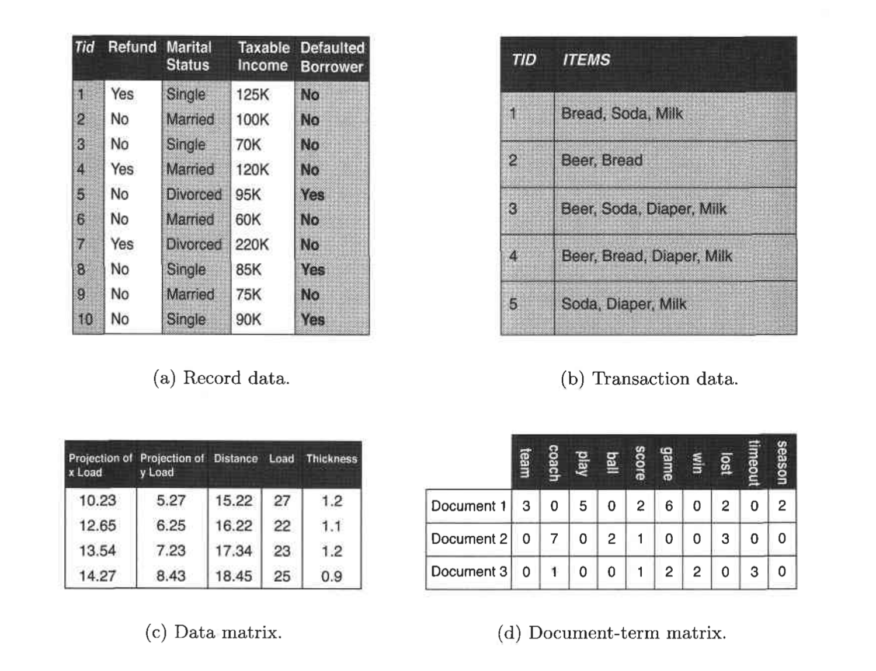

Slide 56
Record Data
Transaction data- Record data→Market basket data
Market basket data because the items in each record are the product in persons market basket.

Slide 57
Transaction or Market Basket Data
It is a special type of record data, in which each record contains a set of items. For example, shopping in a supermarket or a grocery store. For any particular customer, a record will contain a set of items purchased by the customer in that respective visit to the supermarket or the grocery store. This type of data is called Market Basket Data. Transaction data is a collection of sets of items, but it can be viewed as a set of records whose fields are asymmetric attributes. Most often, the attributes are binary, indicating whether or not an item was purchased or not.

Slide 58
Data Matrix (pattern matrix)
If data objects have the same fixed set of numeric attributes, then the data objects can be thought of as points in a multi-dimensional space, where each dimension represents a distinct attribute
Such a data set can be represented by an m by n matrix, where there are m rows, one for each object, and n columns, one for each attribute

Slide 59
Document Data
Each document becomes a ‘term’ vector
Each term is a component (attribute) of the vector
The value of each component is the number of times the corresponding term occurs in the document.

Slide 60
Transaction Data
A special type of data, where
Each transaction involves a set of items.
For example, consider a grocery store. The set of products purchased by a customer during one shopping trip constitute a transaction, while the individual products that were purchased are the items.
Can represent transaction data as record data

Slide 61
Graph Data : Molecular(Data with Objects)
Examples: Generic graph, a molecule, and webpages : Graph Mining : Analyze Graph Data
Benzene Molecule: C6H6

Slide 62
WWW dataset:
Text and link other page
Search Queries on WWW: we collect web pages and process web pages and extract data.

Slide 63
Summarized
Revise Characteristics of data and watch imp. Curse of Dimensionality
Data Set meaning
Exploring Statistical types of datasets: univariate ,multivariate…
Data Mining Datasets:
1. Record Data :Flat File(RDBMS), Transaction Data(Market Basket Transaction Data),Data Matrix(Pattern Matrix), Document Data (e.g. Marksheet of students),sparse Matrix
2. Graph Dataset: WWW dataset : Data and link
Molecular Dataset: Relationship among object(Web
Mining)

Slide 64
Thank you!!!

